Slide 1
Characteristics of UJT

Slide 2
What is Unijunction Transistor (UJT)
UJT stands for UniJunction Transistor. It is a three terminal semiconductor switching device.
The Unijunction Transistor is a simple device that consists of a bar of n-type silicon material with a non-rectifying contact at either end (base 1 and base 2), and with a rectifying contact (emitter) alloyed into the bar part way along its length, to form the only junction within the device (hence the name ‘Unijunction’).
The Unijunction Transistor is also known as Double Base Diode.

Slide 3
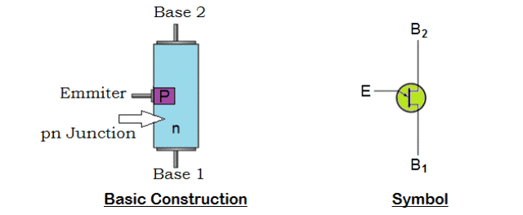
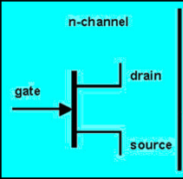
In Unijunction Transistor, the PN Junction is formed by lightly doped N type silicon bar with heavily doped P type material on one side.
The ohmic contact on either ends of the silicon bar is termed as Base 1 (B₁) and Base 2 (B₂) and P-type terminal is named as emitter.
The emitter junction is placed such that it is more close to terminal Base 2 than Base 1.
The symbols of both UJT and JFET resemble the same except the emitter arrowhead represents the direction in which conventional current flow, but they operate differently

Slide 4
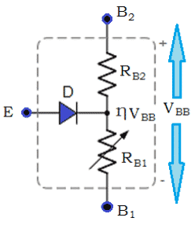
How does a Unijunction Transistor (UJT) works
The simplified equivalent circuit shows that N-type channel consists of two resistors RB2 and RB1 in series with an equivalent diode, D representing the PN junction.
The emitter PN junction is fixed along the ohmic channel during its manufacturing process.
The variable resistance RB1 is provided between the terminals Emitter (E) and Base 1 (B₁),
the RB2 between the terminals Emitter (E) and Base 2 (B₂).
Since the PN junction is more close to B_{2,} the value of RB2 will be less than the variable resistance RB1.
A voltage divider network is formed by the series resistances RB2 and RB1.
When a voltage is applied across the semiconductor device, the potential will be in proportion to the position of base points along the channel.

Slide 5

The Emitter (E) will act as input when employed in a circuit, as the terminal B₁ will be grounded.
The terminal B₂ will be positive biased to B_{1,} when a voltage (V_{BB}) applied across the terminals B₁ and B_{2.}
When the emitter input is zero, the voltage across resistance RB1 of the voltage divider circuit is calculated by
The important parameter of Unijunction Transistor is ‘intrinsic stand-off ratio’ (η), which is resistive ratio of R_{B1} to R_{BB.} Most UJT’s have η value ranging from 0.5 to 0.8.
The PN junction is reverse biased; when small amount of voltage which is less than voltage developed across resistance R_{B1} (ηV_{BB}) is applied across the terminal emitter (E).

Slide 6
Thus a very high impedance is developed prompting device to move into non-conducting state i.e., it will be switched off and no current flows through it.
The UJT begins to conduct when the PN junction is forward biased.
The forward biased is achieved when voltage applied across emitter terminal is increased and becomes more than VRB1.
This results in larger flow of emitter current from emitter region to base region.
Increase in emitter current reduces the resistance between emitter and Base 1, resulting in negative resistance at emitter terminal.
The Unijunction Transistor (UJT) will act as voltage breakdown device, when the input applied between emitter and base 1 reduces below breakdown value i.e., RB1 increases to a higher value. This shows that RB1 depends on the emitter current and it is variable.

Slide 7
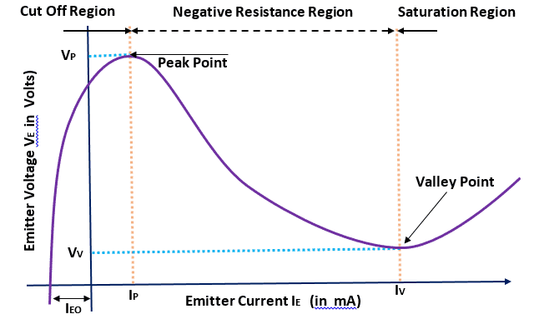
Characteristics Curve of Unijunction Transistor (UJT)
The characteristics of Unijunction Transistor (UJT) can be explained by three parameters:
Cutoff
Negative Resistance Region
Saturation

Slide 8
Cutoff
Cutoff region is the area where the Unijunction Transistor (UJT) doesn’t get sufficient voltage to turn on.
The applied voltage hasn’t reached the triggering voltage, thus making transistor to be in off state.
Negative Resistance Region
When the transistor reaches the triggering voltage, V_{TRIG}, Unijunction Transistor (UJT) will turn on.
After a certain time, if the applied voltage increases to the emitter lead, it will reach out at V_{PEAK}.
The voltage drops from V_{PEAK} to Valley Point even though the current increases (negative resistance).
Saturation
Saturation region is the area where the current and voltage raises, if the applied voltage to emitter terminal increases.

Slide 9
Applications of Unijunction Transistor (UJT)
The Unijunction Transistor can be employed in variety of applications such as:
Switching Device
Triggering Device for Triacs and SCR’s
Timing Circuits
For phase control
In sawtooth generators
In simple relaxation oscillators
Advantages of Unijunction Transistor (UJT)
The advantages of Unijunction Transistor include:
low cost
negative resistance characteristics
Requires low value of triggering current.
A stable triggering voltage
Low power absorbing device
Disadvantage of Unijunction Transistor (UJT)
The main disadvantage of Unijunction Transistor is its inability to provide appropriate amplification.

